Slide 1
LipScribe
A digital assistant that helps people with hearing loss, by converting a speaker's lip movements into text
Team
Gayathri Pulagam
Rishitha Bandi
Shreya Goyal
Surabhi Govil
Advisor
Gopinath Vinodh

Slide 2
Objective
An application to provide people with hearing loss a tool to have more meaningful social conversations.
A useful application for situations where the audio might be corrupted due to background noise.’
A cheap and effective way to overcome speaking disability which could be temporary or permanent.
Explore the potential of neural networks for classification of spatio temporal data.

Slide 3
Project Description
Lip movement to text phrase generation.
The application will capture and decipher the lip movement of a speaker using the camera of a mobile device and display as text to the user

Slide 4
Data Preprocessing
We utilized the LRW dataset which has videos of people speaking words
Due to the computational complexity of the problem, we decided to use 146 commonly spoken words to train our model
We used OpenCV’s video reading library to extract the frames from the video
OpenCV library’s haar cascade face detection model is used to detect the faces in the frame and then subsequently haar cascade mouth detection is used to get the lip region from that face extracted
The extracted lip region is then converted to an embedding to be fed into the CNN model for training

Slide 5
Model Training
We chose to use a 3D Convolutional Neural Network to solve our problem
They work by applying a 3 dimensional filter to the dataset which moves in 3-directions (x, y, z) to calculate the low level feature representations
We trained the model using the video embeddings and the corresponding word spoken in that particular video
We achieved a train accuracy of 0.75, validation accuracy of 0.69 and a test accuracy of ~0.60

Slide 6
Android Application Development
Integrated python components in Android studio using chaquopy.
Developing application using Java 8 and python to run preprocessing on recorded video.
Extracted frames using python and send it to deep learning model for prediction.
Added loading screen using async task to run prediction of the model in background.

Slide 7
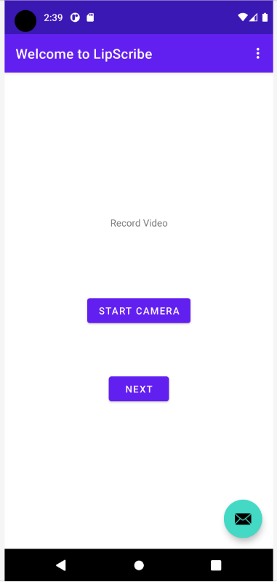
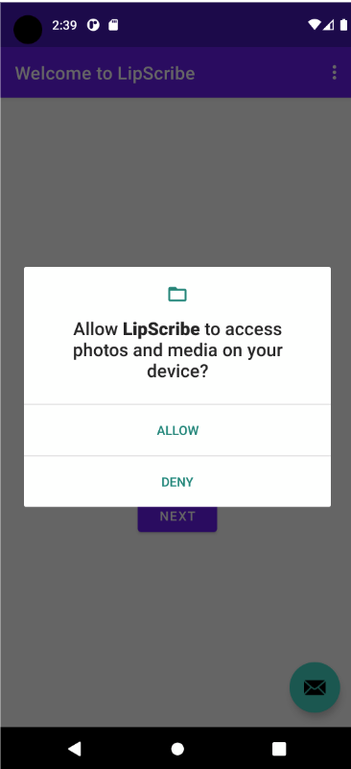
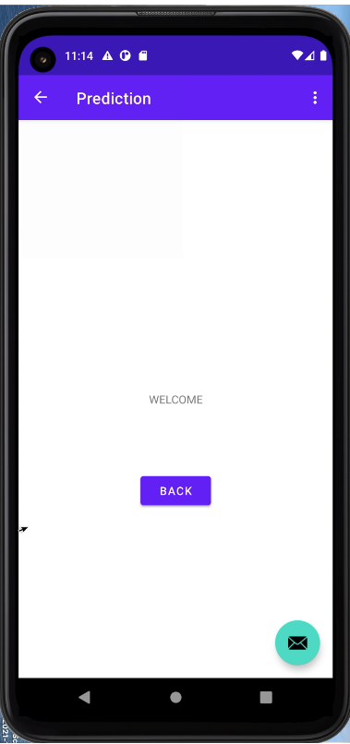
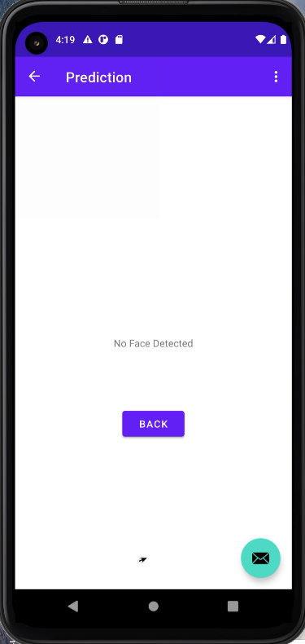
Application Snapshots

Slide 8
Challenges encountered
We ran into computational resource issues as we had to train our model on a large amount of video data
With the limited computational resources we could achieve about 0.60 accuracy on the test dataset
We faced programming language compatibility issues when trying to integrate the trained model into the LipScribe application
To overcome the programming language compatibility issues, we used chaquopy library

Slide 9
Future Work
Training the model with a lower learning rate would result in better performance
The model’s vocabulary can be increased by training the model on more words
The model’s inference time in the android application can be enhanced by using model caching techniques

Slide 10
Team
For any questions please contact -
Rishitha Bandi (015237521) - rishitha.bandi@sjsu.edu
Gayathri Pulagam (014629290) - gayathri.pulagam@sjsu.edu
Shreya Goyal (015251990) - shreya.goyal@sjsu.edu
Surabhi Govil (014504984) - surabhi.govil@sjsu.edu
Project code - https://github.com/surabhigovil/LipScribe

Slide 11
Acknowledgement
We are deeply indebted to Prof. Gopinath Vinodh for his guidance throughout the course of this project
We would like to thank Prof. Dan Harkey and the Department of Software Engineering for providing us with this opportunity to develop and showcase our project

Slide 12
References
[1] Yao WenJuan, Liang YaLing and Du MingHui, "A real-time lip localization and tacking for lip reading," 2010 3rd International Conference on Advanced Computer Theory and Engineering(ICACTE), 2010, pp. V6-363-V6-366, doi: 10.1109/ICACTE.2010.5579830.
[2] P. Sindhura, S. J. Preethi and K. B. Niranjana, "Convolutional Neural Networks for Predicting Words: A Lip-Reading System," 2018 International Conference on Electrical, Electronics, Communication, Computer, and Optimization Techniques (ICEECCOT), 2018, pp. 929-933, doi: 10.1109/ICEECCOT43722.2018.9001505.
[3] J. S. Chung, A. Senior, O. Vinyals and A. Zisserman, "Lip Reading Sentences in the Wild," 2017 IEEE Conference on Computer Vision and Pattern Recognition (CVPR), 2017, pp. 3444-3453, doi: 10.1109/CVPR.2017.367.
[4] B. Lin, Y. Yao, C. Liu, C. Lien and B. Lin, "Development of Novel Lip-Reading Recognition Algorithm," in IEEE Access, vol. 5, pp. 794-801, 2017, doi: 10.1109/ACCESS.2017.2649838.
[5] M. A. Abrar, A. N. M. N. Islam, M. M. Hassan, M. T. Islam, C. Shahnaz and S. A. Fattah, "Deep Lip Reading-A Deep Learning Based Lip-Reading Software for the Hearing Impaired," 2019 IEEE R10 Humanitarian Technology Conference (R10-HTC)(47129), 2019, pp. 40-44, doi: 10.1109/R10-HTC47129.2019.9042439.
[6] P. Sujatha and M. R. Krishnan, "Lip feature extraction for visual speech recognition using Hidden Markov Model," 2012 International Conference on Computing, Communication and Applications, 2012, pp. 1-5, doi: 10.1109/ICCCA.2012.6179154.
[7] "SRAVI - Speech Recognition App for the Voice Impaired." https://www.sravi.ai/. Accessed 7 Jul. 2021.
[8] "Luvius Lip Reading – Patented speech-to-text innovation." http://luvius.nl/. Accessed 7 Jul. 2021
[9] "LipNet is the most accurate lip-reading software ever ... - Mashable." 9 Nov. 2016, https://mashable.com/article/lipnet-lipreading-software. Accessed 7 Jul. 2021.
[10] “LipNet - End-to-End Sentence-level Lipreading.” https://www.researchsnipers.com/wp-content/uploads/2021/05/Lipnet.pdf
[11] "Sony's New Lip-Reading Technology Could Boost ... - PCMag." 13 Jan. 2021, https://www.pcmag.com/news/sonys-new-lip-reading-technology-could-boost-accessibility-or-invade-privacy. Accessed 7 Jul. 2021
[12] LRW, Lip Reading in the Wild. Retrieved from
https://www.robots.ox.ac.uk/~vgg/data/lip_reading/lrw1.html

Slide 13
Thank You

